Slide 1

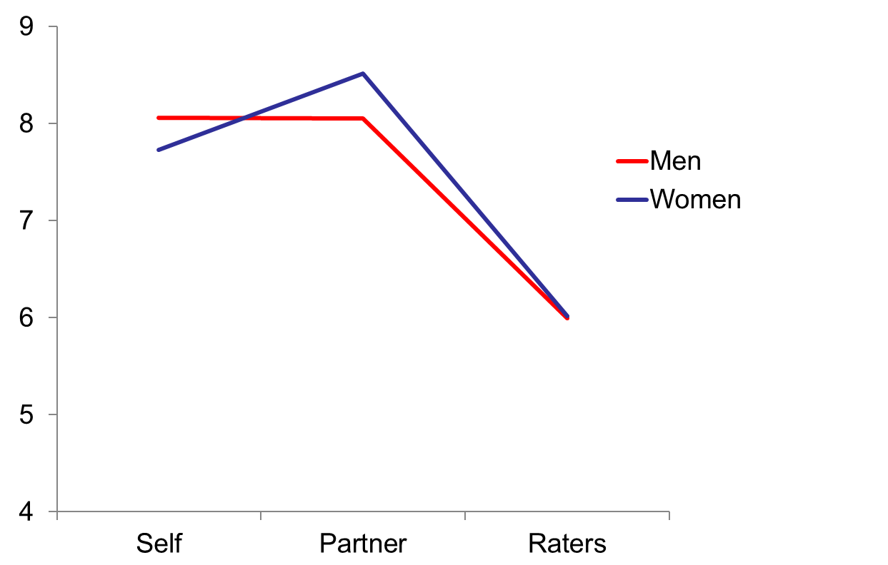

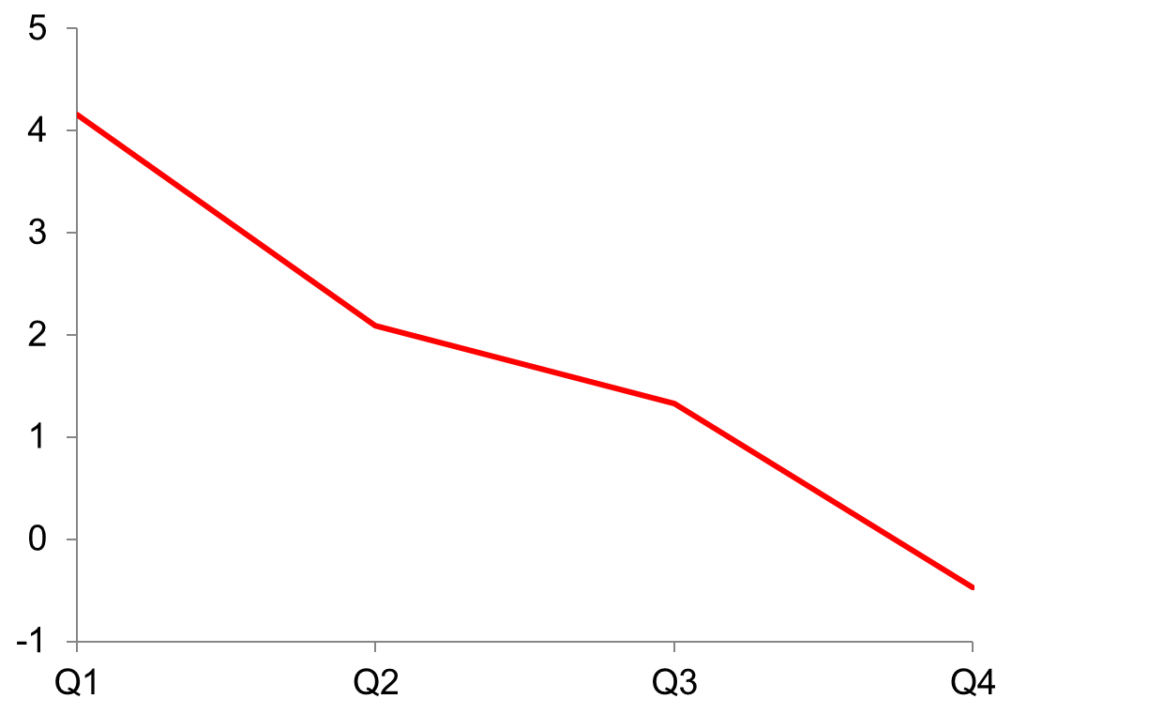

My, But We are Impressive! Mate-Value Enhancement in Romantic Couples
Jason E. Piccone & Glenn J. Scheyd, Jr.
Nova Southeastern University, Farquhar College of Arts and Sciences, Division of Social and Behavioral Sciences
Abstract
While people reliably partner with others of a similar mate-value (MV), perceptions of MV are subject to strong perceptional biases. 40 romantic couples were evaluated such that their MV was compared across three sources: their self-perceptions, the perceptions of their romantic partner, and perceptions by third party raters. Results indicate a profound exaggeration of one’s own and one’s partner’s MV, relative to the raters.
Results
1. Participants rated their overall MV (M = 7.90) and their romantic partner’s overall MV (M = 8.28) significantly higher than the raters (M = 6.00), F (2, 219) = 53.05, p < .001 (see Figure 1). Analyses for individual traits were comparable to these results.
2. Overall MV ratings between individuals and their partners were uncorrelated (r = -.024), as were correlations between individuals and the raters (r = .015) and partners and raters (r = 147). Individuals scored their own MV as similar to their partners (r = .517, p < .001). Individuals who received the lowest overall MV scores by raters also demonstrated the greatest inflation in self-reported MV (relative to the raters), F(3, 63) = 31.144, p < .001 (Figure 2).
3. Raters indicated a close overall MV match among romantic couples (r = .485, p < .01).
4. Table 1 presents significant trait predictors of overall MV by the raters.
Table 1. Predictors of Overall MV by Raters
Figure 1. Overall Mate-Value by Perceiver
 | Variable | Std. Coefficient
Men | Attractive Body | .402***
 | Exciting Personality | .371***
 | Financial Prospects | .258***
 | Common Sense | .194***
 | Sense of Humor | .120**
Women | Attractive Body | .366***
 | Common Sense | .342***
 | Attractive Face | .303**
 | Athletic | .173*
***p < .001 ** p < .01 *p < .05
Hypotheses
Participants will inflate MV perceptions of themselves and their romantic partners relative to the raters.
Participants who are rated lower (bottom two quartiles) by observers will inflate their MV perceptions more (than the upper two quartiles).
Raters will indicate a close overall MV between romantic partners.
Raters will indicate greater weight for reproductive potential for women. Raters will indicate greater weight for wealth/income potential variables and attributes related to relationship commitment and willingness to invest in offspring for men.
Method
Participants
· 40 committed, heterosexual romantic couples.
· 36.3% Caucasian, 35% Hispanic, 12.5% African American, 11.3% Asian, 5% other.
· Ages 18-54, mean = 22.08.
· Relationship length 1-204 months, mean = 25.28.
Materials
Demographics. Age, sex, ethnicity, weight, height, G.P.A, marital and reproductive history, and health.
MV perceptions. Participants responded to Kirsner et al.’s (2013) scale to measure their perceptions of their own and their partner’s MV. These items measured 17 traits (e.g. attractive body, intelligent, loyal). In addition, participants indicated their/their partner’s overall MV (1-10).
Procedure
After informed consent, participants were separated and led to private rooms to complete the questionnaire and interview. The questionnaire took approximately 30 minutes to complete while the interview lasted an average of about 8 minutes. Interviews were viewed and coded by a minimum of three researchers (raters). Interview questions were meant to assess various facets of MV (such as participant sociability, attractive face and body, etc.) in addition to a rating of each participant’s overall MV. Interrater reliability ranged from a
low of .886 (attractive face) to a high of .958 (overall).
Source of Mate-Value Ratings
Figure 2. Self – Rater Overall Mate-Value Discrepancy by Quartiles
Discussion
Our findings are consistent with others (e.g., Watson, et al., 2005) that individuals will partner with similarly valued others. While participants were consistent with assortative mating, they displayed a strong tendency to inflate their self and partner perceptions, relative to the raters. Individuals who were rated to have the lowest MV by raters demonstrated the greatest degree of self-perceived MV enhancement. Future research could examine how people place the greatest weight on attributes in which they are strongest (relative to others) and de-emphasize attributes in which they are weak, when formulating their self- perceived MV.
Quartiles of Raters’ Mate-Value Perceptions

